Slide 1

Government College of Engineering, Karad (An Autonomous Institute of Government of Maharashtra) Department of Information Technology
Final Year B.Tech. [Winter-2022]
Seminar IT2711
REVIEW – II
Title: Question Paper Moderation
Name of Guide: | Group No: | Group Members:
Dr. B. S. Yelure | 6 | Shubham Sanjay Pawar [20141236] Vishal Hindurao Kamble [20141234] Mohsina Akbar Mulani [20141152] Shridhar Rambhau Atram [20141238] Hritik Pandurang Parbat [20141218]

Slide 2
CONTENTS:
1 | Introduction
 | Objective
2 | Literature Survey
3 | Proposed Methodology
 | Proposed System Architecture
 | Methodology
4 | Module Implementation
5 | Conclusion References

Slide 3
Introduction
Question Paper Moderation proposes an innovative system designed to measure semantic similarity between question papers, utilizing a combination of similarity score and BERT.
The primary goal is to revolutionize the assessment process by automating the comparison of question papers, enhancing efficiency, and maintaining academic integrity.
The system comprises several key components, including data collection, text extraction, text cleaning, stop word removal, tokenize the text, vectorize the text, use BERT model to emebbed text, cosine similarity, generate unique question paper and a user-friendly interface.
BERT is used encode the words of question papers which gives accurate semantic similarity scores. Through comprehensive documentation and ongoing maintenance, this system aims to serve as a valuable tool for educational institutions, aiding in the streamlined evaluation of question papers while upholding the highest standards of academic rigor and efficiency.

Slide 4
Objective
Main objective of seminar project are as follows:
Provide the similarity between pair of question paper.
Generate the unique question paper.
Reduce the redundancy for storing more important data.
Using BERT model, calculate similarity score.
By accomplishing all these objectives, a better solution is produced by automating question paper moderation process.

Slide 5
Literature Survey
Sr.No. | Research Paper Title | Authors | Model Type | Results
1) | "Question to Question Similarity Analysis Using Morphological, Syntactic, Semantic, and Lexical Features" | Muntaha Al-asa’d, Nour Al-khdour, Mutaz Bni Younes | XGBoost, SVM, Random Forest, NLP | Check similarity of question in database [4]
2) | "Evaluating Cold-Start in Recommendation Systems Using a Hybrid Model Based on Factorization Machines and SBERT Embeddings" | SABRINA CHOWDHURY | BERT – Paraphrase-MiniLM-L3-v2 | Pre-trained SBERT model showed that the paraphrase-MiniLM-L3-v2 model displayed the smallest franchise distance.[5]
3) | " DistilBERT, a distilled version of BERT: smaller, faster, cheaper and lighter " | Victor SANH, Lysandre DEBUT, Julien CHAUMOND, Thomas WOLF | BERT – All-Distilroberta-v1 | A general-purpose pre-trained version of BERT, 40% smaller, 60% faster, that retains 97% of the language understanding capabilities.[6]
4) | " Evaluating Dense Passage Retrieval using Transformers" | Nima Sadri | BERT – Multi-qa-distilbert-cos-v1 | For each query-document pair, computes the relevance score based on the dot product of the document and query embedding.[7]
5) | Duplicate Question Detection with Deep Learning in Stack Overflow | JING JIANG, LI ZHANG AND LITING WANG | CNN, RNN LSTM | Solve the problem of duplicate questions using Word2vec CNN, RNN. [1]

Slide 6
Proposed Methodology
Text Extraction
Text Cleaning and Tokenization
Stopword Removal
Text Vectorization
BERT Model for Text Embedding
Cosine Similarity
N^2 Approach for Question Paper Generation

Slide 7
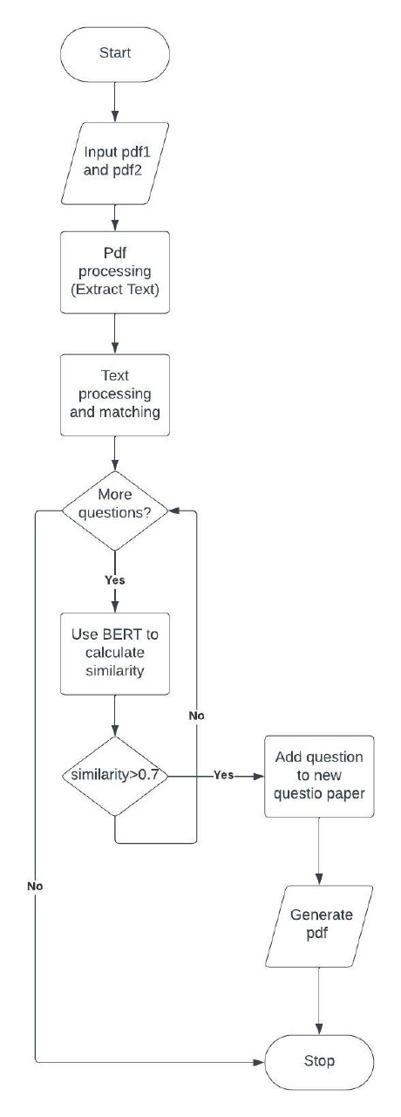
Module Implementation
Figure 5.1. PDF Question Comparison and Merging Process
9

Slide 8
Question pair
Pre - Processing
Data Cleaning: Stop word removing, tokenization, Lemmatization
BERT Mode1:
Paraphrase-MiniLM-L3-v2
BERT Mode2:
All-distilbrob
BERT Mode3:
Multi-qa-distilroberta-v1
Calculate Avg. Similarity Score
Figure 5.2. Flowchart of similarity score calculation
Similarity Score

Slide 9
Conclusion
The implementation of the proposed system architecture, incorporating NLP, and diverse algorithms, has successfully automated the question paper moderation process. This automation significantly reduces the time and effort required for manual moderation.
The research has shown that automated moderation leads to a substantial improvement in the quality, relevance, and fairness of question papers. By employing advanced feature extraction methods and algorithm selection, we can effectively identify and rectify inconsistencies in question papers.
The use of BERT and NLP for question paper moderation optimizes resource utilization in educational institutions. This automated process ensures that educators can allocate their time and expertise to other critical tasks while maintaining the integrity of assessments.

Slide 10
References
JING JIANG, LI ZHANG AND LITING WANG “Duplicate Question Detection with Deep Learning in Stack Overflow” (2020). [DOI:10.1109/ACCESS.2020.2968391]
Ms. Vishwaja M. Tambakhe, Dr. Kishor P. Wag “Review on Exploring Similarity between two Questions using Machine Learning”. [DOI: https://doi.org/10.32628/CSEIT217360]
R. Rishickesh, R.P. Ram Kumar, A. Shahina, A. Nayeemullah Khan “Identification of Duplication in Questions Posed on Knowledge Sharing Platform Quora using Machine Learning Techniques'”. [DOI:10.35940/ijitee. L3017.1081219]
M. Al-Asa'd, N. Al-Khdour, M. B. Younes, E. Khwaileh, M. Hammad and M. AL-Smadi, "Question to Question Similarity Analysis using Morphological, Syntactic, Semantic, and Lexical Features," 2019 IEEE/ACS 16th International Conference on Computer Systems and Applications (AICCSA), Abu Dhabi, United Arab Emirates, 2019, pp. 1-6, doi: 10.1109/AICCSA47632.2019.9035248.
Chowdhury, S. (2022). Evaluating Cold-Start in Recommendation Systems Using a Hybrid Model Based on Factorization Machines and SBERT Embeddings (Dissertation). Retrieved from https://urn.kb.se/resolve?urn=urn:nbn:se:kth:diva-321357”
Victor Sanh, Lysandre Debut, Julien Chaumond, Thomas Wolf “ DistilBERT, a distilled version of BERT: smaller, faster, cheaper and lighter” https://doi.org/10.48550/arXiv.1910.01108
Sadri, Nima. (2022). Evaluating Dense Passage Retrieval using Transformers. 10.48550/arXiv.2208.06959.
https://huggingface.co/sentence-transformers/paraphrase-MiniLM-L3-v2

